Slide 1
Lecture 8 CUDA Parallel Reduction Problem
Kyu Ho Park
April 11, 2017
Ref: 1.[PCCP]Professional CUDA C Programming, Cheng,Grossman,McKercher,2014.
2.[Harris]Optimizing Parallel Reduction in CUDA, Mark Harris, NVIDIA Developer Technology.

Slide 2
Parallel Reduction Problem
---------------------------------------------------------
int sum=0;
for(int i=0; i<N; i++) sum+=array[i];
---------------------------------------------------------
If N is a huge number, you will do:
1. Partition the input vector into smaller ones,
2. Calculate the partial sum by a thread,
3. Add the partial sum into a final sum.

Slide 3
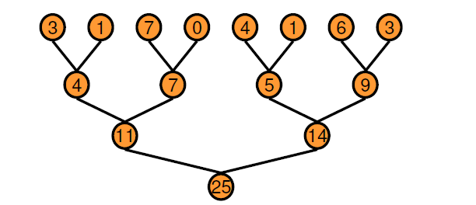
Pairwise Parallel Sum
[Harris]

Slide 4
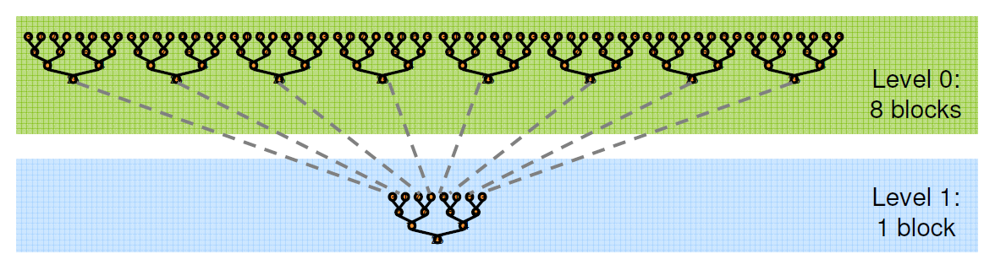
Parallel Reduction
[Harris]

Slide 5
Reduction
Performing a commutative(교환 법칙) and associative(결합 법칙) operation across a vector is called the reduction.
Parallel Reduction

Slide 6
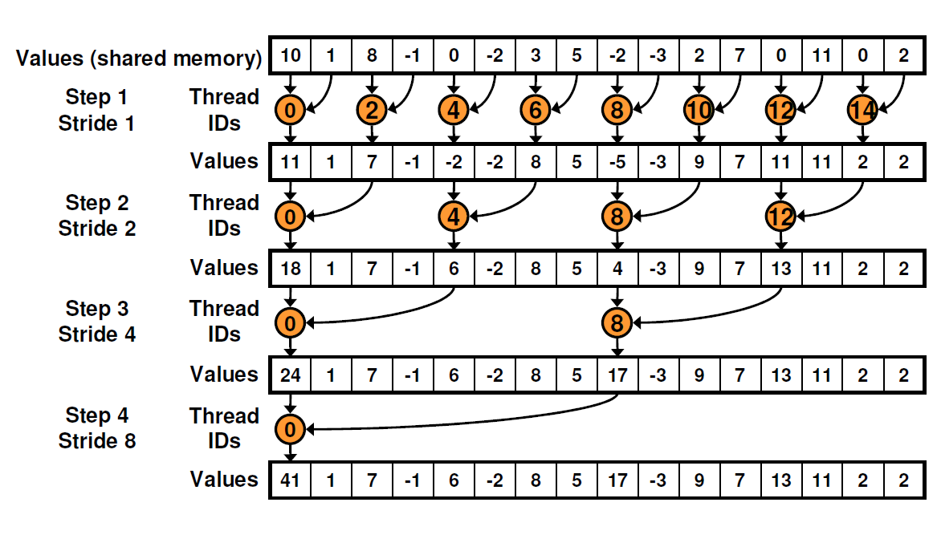
Step 1:Parallel Reduction
Global Memory
in place replace
for( int stride =1; stride<blockDim.x; stride*=2) { }
coalesced 아니기 때문에 cache 성능이 떨어진다.
[Harris]
*The partial results are stored in-place in the original input vector.

Slide 7
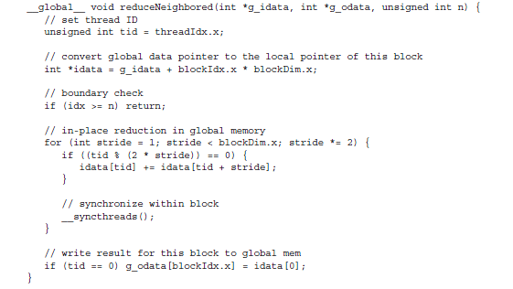
parallel reduction
unsigned int idx = blockIdx.x*blockDim.x + thredIdx.x
warp divergence
stride: the distance between two neighbor elements.
[PCCP]

Slide 8
in-place reduction: the values in global memory are replaced by partial sums at each step.
if((tid%(2*stride))==0) is true for even numbered threads ,
it causes divergent warps.
at the first reduction, only even numbered threads satisfy the condition, but all threads must be scheduled.
at the second reduction, only ¼ threads are active, but still all threads are scheduled.
warp divergence can be reduced by rearranging the array index to force neighboring threads to perform the addition.

Slide 9
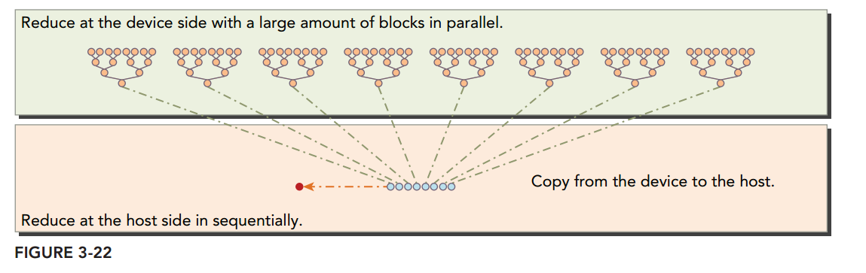

Slide 10
Warp Divergence
All threads in a warp must execute identical instructions on the same cycle.
If threads in the same warp take different paths, what will happen?
if( condition) { }
else { }
Warp Divergence : Threads in the same warp executing different instructions.

Slide 11
Threads in a warp divergence
if(condition) then { } else { }
if(condition)
then{ }
else-threads stall
serialization
else{ }
then-threads stall

Slide 12
Warp Divergence
Conditional execution within a warp may cause warp divergence that can lead to kernel performance degradation.
We can reduce the warp divergence using parallel reduction.

Slide 13
Step2:Neighboring threads
int index=2*stride*tid;
if(index < blockDim.x){
idata[index] += idata[index+stride];
}
tid=0,stride=1: index=0; idata[0]+=idata[1];
tid=1,stride=1: index=2; idata[2]+=idata[3];
tid=2,stride=1: index=4; idata[4]+=idata[5];
…………..

Slide 14
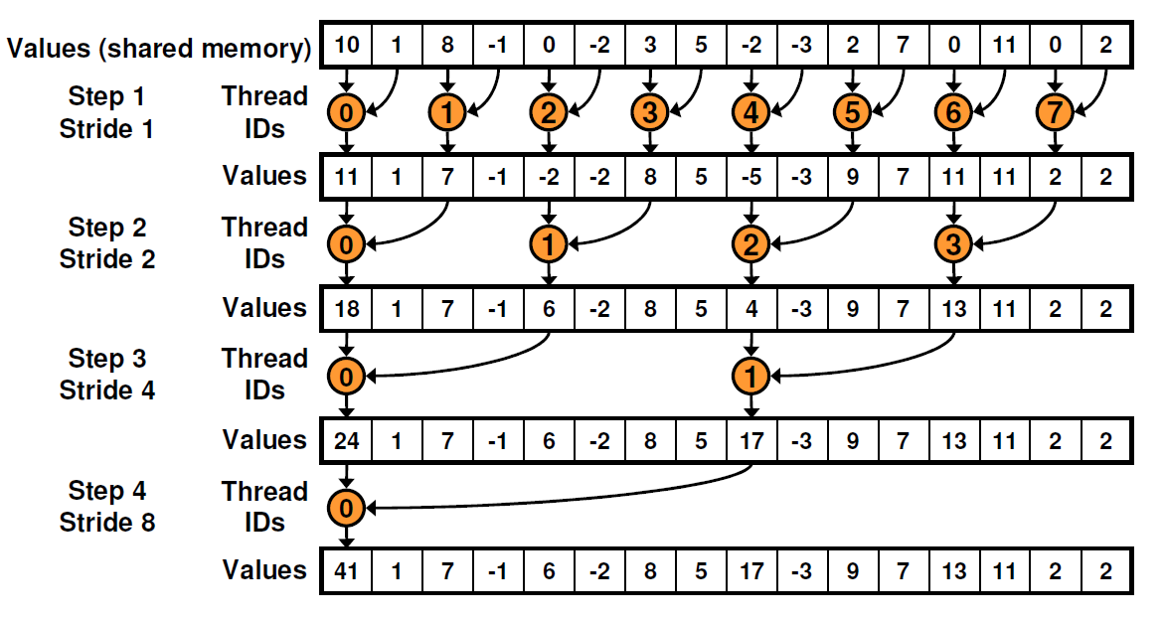
Improving Parallel Reduction
if(tid %(2*stride))==0)
Global Memory
1
2
3
1
[Harris]

Slide 15
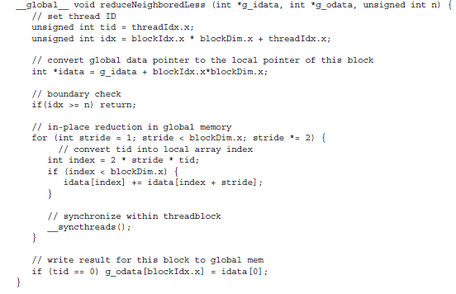

Slide 16
There is no divergence
Only half of the warp execute the reduction at the first round.
At the second round, ¼ of the warp execute and the others do nothing.
Divergence only occurs in the last 5 rounds when the total number of threads at each round is less than the warp size

Slide 17
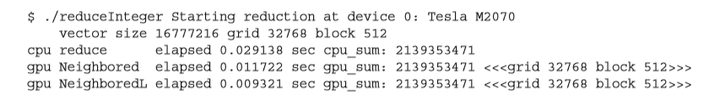
Performance

Slide 18
Step3:Reducing with Sequential Addressing
instead of
int index=2*stride*tid;
, replace it with
for(int stride=blockDim.x/2; stride >0; stride>>=1){ }.

Slide 19
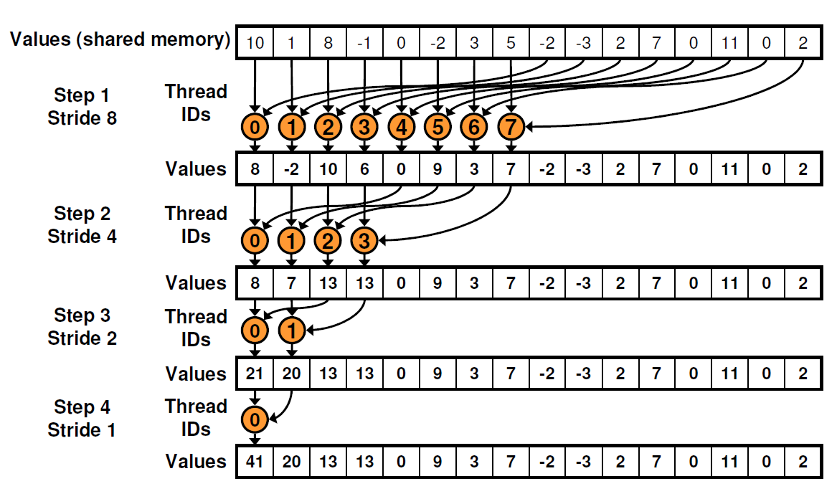
Parallel Reduction with Seq. Addressing
Global Memory
[Harris]
coalesced 해서 이전 것보다 performance 향상된다.

Slide 20
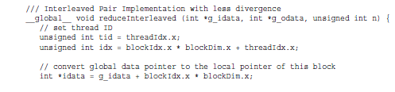
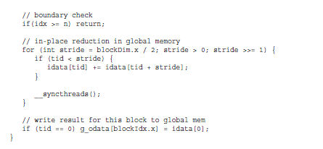

Slide 21
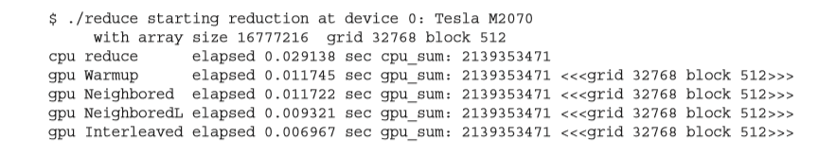
Performance

Slide 22
The major improvement of performance comes from the memory read and write patterns of global memory.
The interleaved reduction is 1.69 times faster than the step 2 implementation. Why?
- coalesced cache access !

Slide 23
Step 4:Unrolling Loops
Loop unrolling: it is a technique to reduce the frequency of branches and loop instructions.
Loop unrolling factor: the number of copies made of the loop body. -> 단점 : binary code size increase by factor of loop unrolling factor !
Example:
for(int i=0; i<100; i++){
a[i]=b[i]+c[i];
}
for(int i=0; i<100; i+=2){
a[i]=b[i]+c[i];
a[i+1]=b[i+1]+c[i+1];
}

Slide 24
Unrolling loops
Unrolling loops: it is a loop transformation technique that attempts to optimize the execution speed of a program at the expense of its binary size. The transformation can be undertaken manually by the programmer or by an optimizing compiler.
The unrolling loops is to increase the execution speed of a program by reducing or eliminating instructions that control the loop, reducing branch penalty, as well as hiding latency.
Loop are rewritten as a repeated sequence of similar independent statements.
Improving performance by reducing instruction overheads and creating more independent instructions to schedule.
As a result, more concurrent operations are added to the pipeline leading to higher saturation of instruction and memory bandwidth. This provides the warp scheduler with more eligible warps that can help hide instruction or memory latency

Slide 25
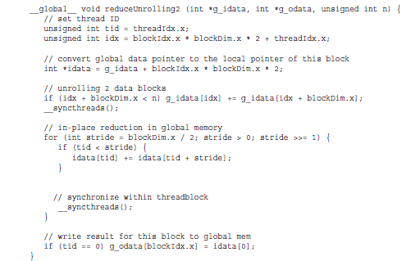
Reducing with Unrolling
[PCCP]

Slide 26
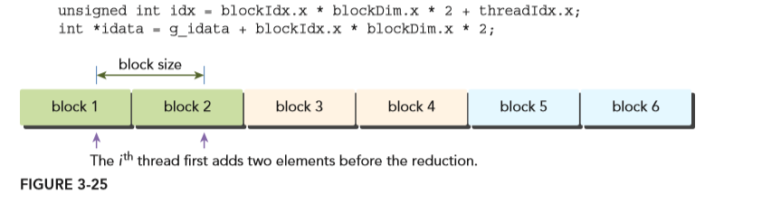
Reducing with Unrolling
if(idx+blockDim.x<n) g_idata[idx] += g_idata[idx+blockDim.x];
: Each thread is adding an element from neighboring data block.
because you only need half as many thread blocks to process the same data set
We can obtain faster execution than the previous one.

Slide 27
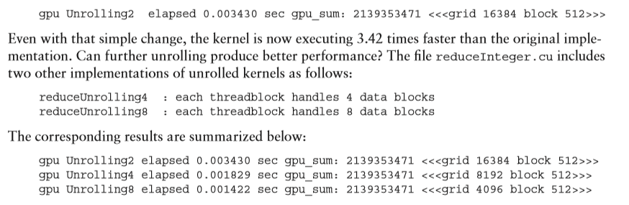
Performance

Slide 28
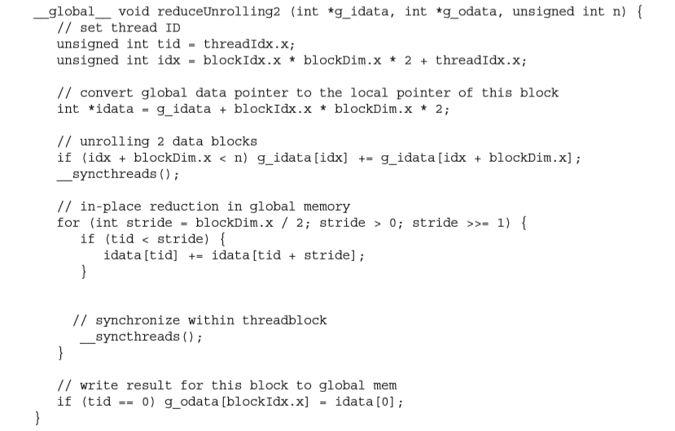
Step 5: Reducing with Unrolled Warps
[PCCP]

Slide 29
Unrolled warp
for( int stride=blockDim.x/2; stride > 0; s>>=1){
if(tid < stride)
{ idata[tid]+=idata[tid+stride]; }
__syncthreads( );
}
if (stride <=32), there will be only one warp remained.
If there is only one warp in a block, __syncthreads( ); is not necessary, since all threads in a warp are all synchronized.
Cause warp execution is SIMT, there is implicit intra-warp synchronization after each instruction.
__syncthreads( ):
When a kernel calls __syncthreads(), the threads that executes the function call will be held at the calling location until every thread in the block reaches the location.

Slide 30
Unrolled warp
for( int stride=blockDim.x/2; stride > 0; s>>=1){
if(tid < stride)
{ idata[tid]+=idata[tid+stride]; }
__syncthreads( );
}
when stride <=32, the for–loop can be unrolled as follows:
if( tid < 32) {
idata[tid] +=idata[tid+32];
idata[tid] +=idata[tid+16];
idata[tid] +=idata[tid+8];
idata[tid] +=idata[tid+4];
idata[tid] +=idata[tid+2];
idata[tid] +=idata[tid+1];
}

Slide 31
Unrolled warp
For example
tid 1 2 3 4 5 6 7 8
1+5 2+6 3+7 4+8
1+5+3+7 2+6+4+8
1+2+3+4+5+6+7+8

Slide 32
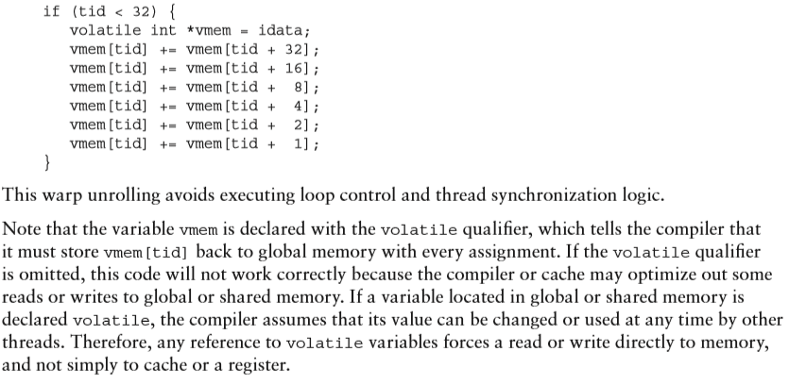
volatile qualifier

Slide 33
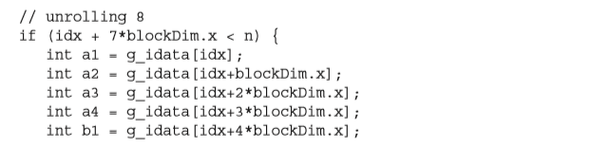
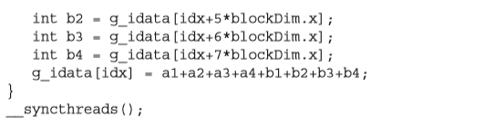
datablocks unrolling

Slide 34
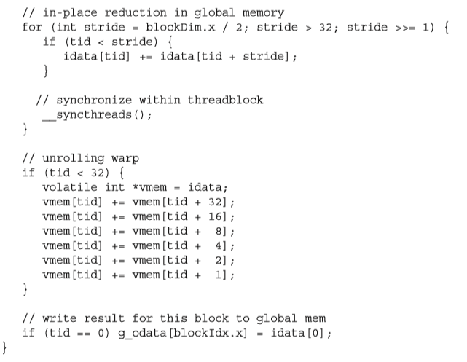

Slide 35
Step 6: Reducing with Complete Unrolling
for( int stride=blockDim.x/2; stride > 32; s>>=1){
if(tid < stride)
{ idata[tid]+=idata[tid+stride]; }
__syncthreads( );
}
The maximum number of threads per block on Fermi and Kepler is limited to 1024. It is possible to unroll whole loop as follows:

Slide 36
Step 6: Reducing with Complete Unrolling
if (blockDim.x>=1024 && tid <512) idata[tid] +=idata[tid+512];
__syncthreads();
if (blockDim.x>= 512 && tid <256) idata[tid] +=idata[tid+256];
__syncthreads();
if (blockDim.x>= 256 && tid <128) idata[tid] +=idata[tid+128];
__syncthreads();
if (blockDim.x>= 128 && tid < 64) idata[tid] +=idata[tid+64];
__syncthreads();
for( int stride=blockDim.x/2; stride > 32; s>>=1){
if(tid < stride)
{ idata[tid]+=idata[tid+stride]; }
__syncthread(); }

Slide 37
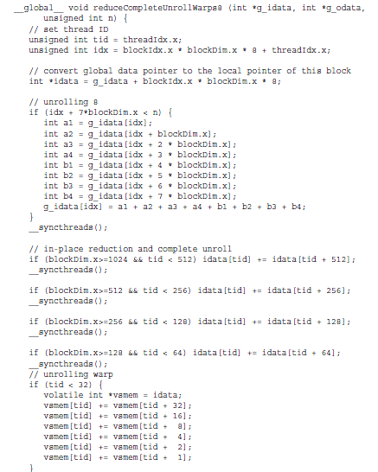

Step 6: Reducing with Complete Unrolling
[PCCP]

Slide 38
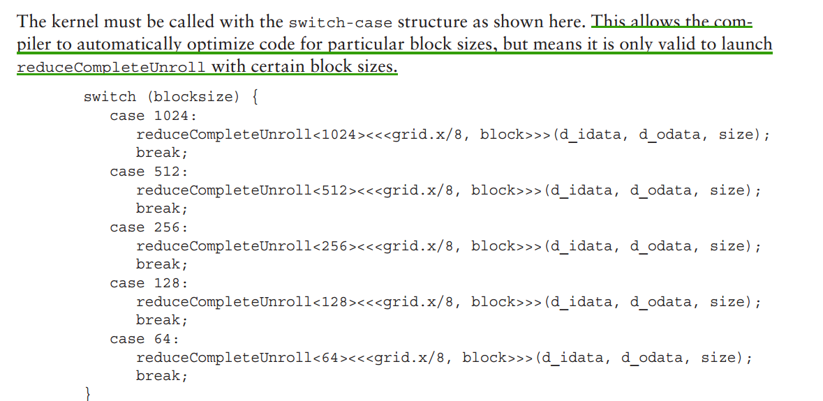
Reducing with Template Functions
While it is possible to manually unroll loops, using template functions can help to further reduce branch overhead. The only difference compared to reduceCompleteUnrollWarps8 is that you replaced block size with a template parameter. The if statements that check the block size will be evaluated at compile time and removed if the condition is not true, resulting in a very efficient inner loop.

Slide 39
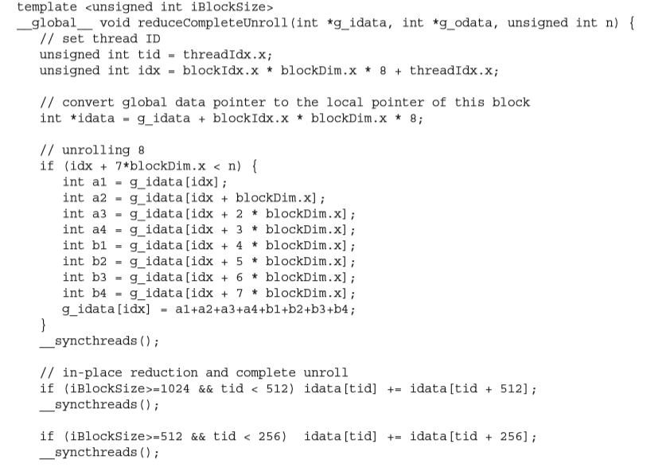
Reducing with Template Functions

Slide 40
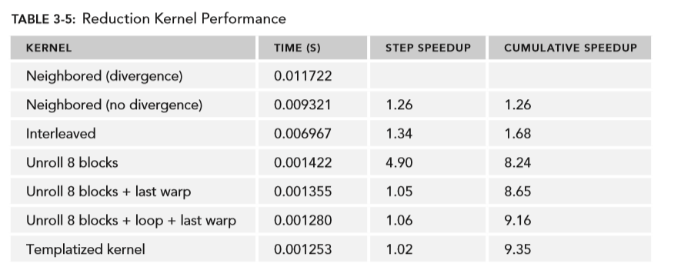
Performance

Slide 41
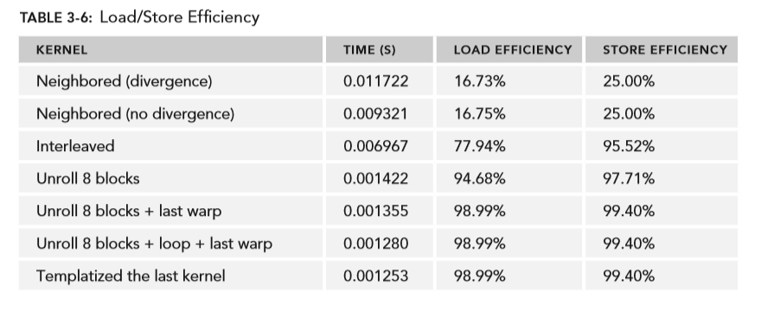
Load/Store Efficiency

Slide 42


Presentation Schedule on April 27
Mr. Jorge Mario Loaiciga Rodriguez
Mr. 박진우
Graphics and CUDA:
1.Introduction to Graphics Programming
2.Texture Functions(B.8) and Surface Functions(B.9)
at CUDA C Programming Guide v.8.0, NVIDIA.

Slide 43
Midterm exam.
Date , Time and Place:
April 20(Thu.) 9:00~11:45 AM at Room2220
Closed Book Test.
Scope: Lectures 1~ Lecture 8
and All articles presented by students.

